Slide 1
WIRESHARK NETWORK ANALYSIS Part 2
WIRESHARK ANALYZE OF MALICIOUS TRAFFIC
PRESENTED BY: SIMON THORNTON, RAJESH YELURI & BHARGAVA R THALLURU

Slide 2
Illegal Downloads

Slide 3
Illegal Downloads
Initial Information
IT was informed that some users are torrenting on the network. The Security team does not forbid the use of torrents for legitimate purposes, such as downloading operating systems. However, they have a strict policy against copyright infringement.
IT shared the following about the torrent activity:
The machines using torrents live in the range 10.0.0.0/24 and are clients of an AD domain.
The DC of this domain lives at 10.0.0.2 and is named DogOfTheYear-DC.
The DC is associated with the domain dogoftheyear.net.

Slide 4
Illegal Downloads
Required Information
Following information about the machine with IP address 10.0.0.201:
MAC address
Windows username
OS version
Torrent file the user download

Slide 5
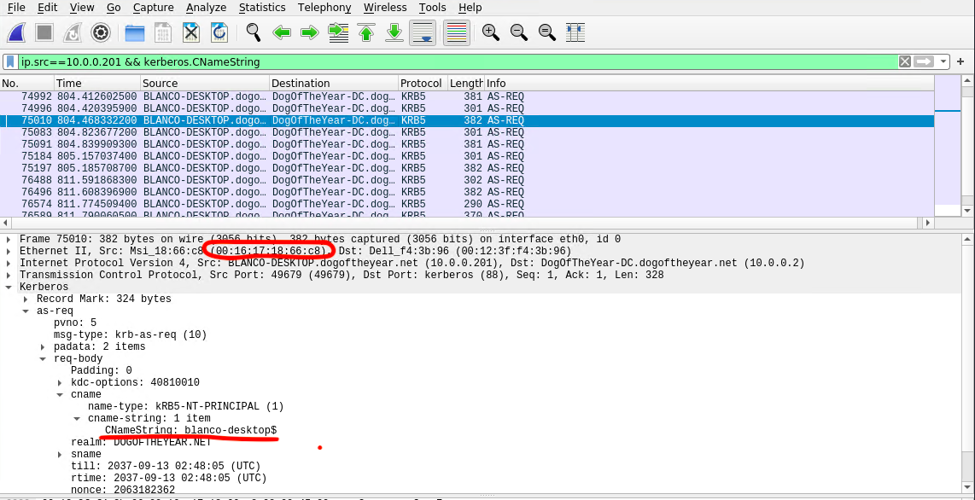
Illegal Downloads
Finding details of the machine with IP address 10.0.0.201
After applying the display filter to show traffic from ip.src==10.0.0.201 && kerberos.CNameString, we were able to find the MAC address: 00:16:17:18:66:c8

Slide 6
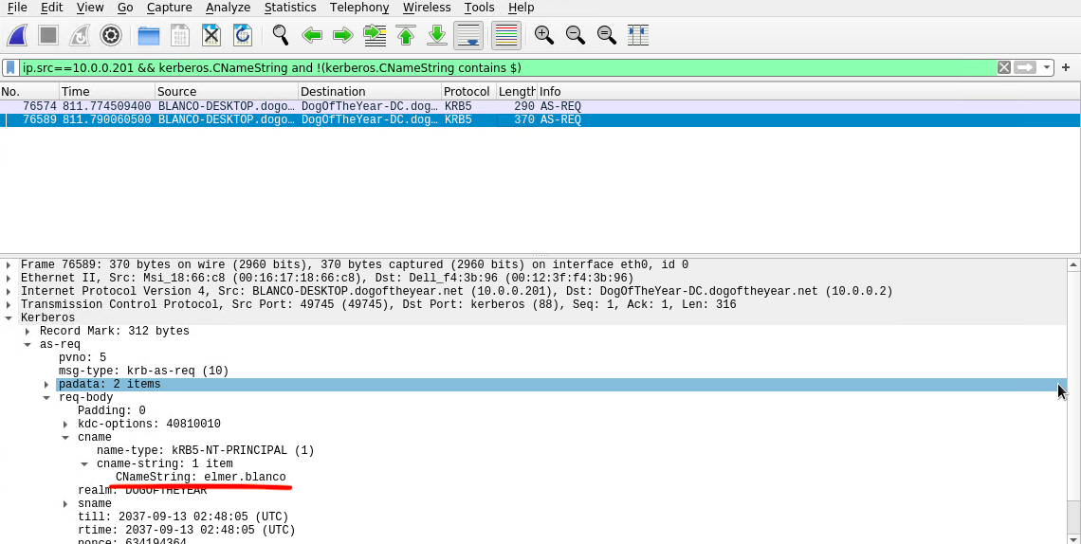
Illegal Downloads
Finding username of the machine with IP address 10.0.0.201
By applying the display filter to show traffic from ip.src==10.0.0.201 && kerberos.CNameString and !(kerberos.CNameString contains $) we were able to find the username: elmer.blanco

Slide 7
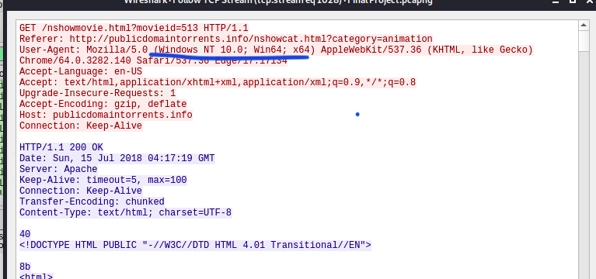
Illegal Downloads
Finding OS of the machine with IP address 10.0.0.201
By filtering the packets ip.src==10.0.0.201 && tcp and following the one of the ACK packet, by right click on the packet and selecting follow TCP stream, were able to find the OS of the device: Windows NT 10.0

Slide 8
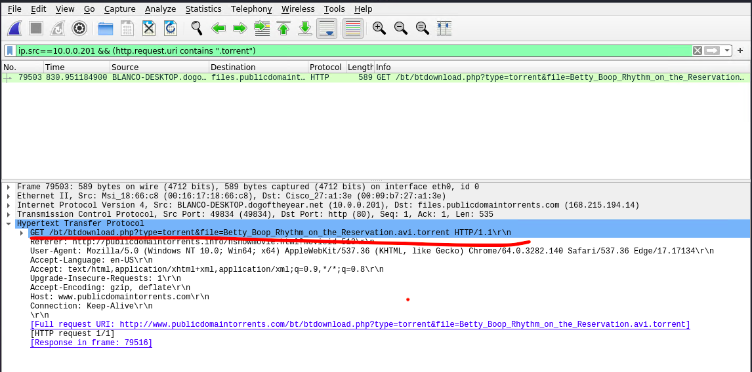
Illegal Downloads
Torrent file the user download
As we know the user and IP address of the machine, simply applying the following filter ip.src==10.0.0.201 && (http.request.uri contains “.torrent”) will display the download file which is “Betty_Boop_Rhythm_on_the _Reservation.avi”

Slide 9
The End

Slide 10
Any Questions?

Slide 11
Thank you! To all of you!

